Slide 1


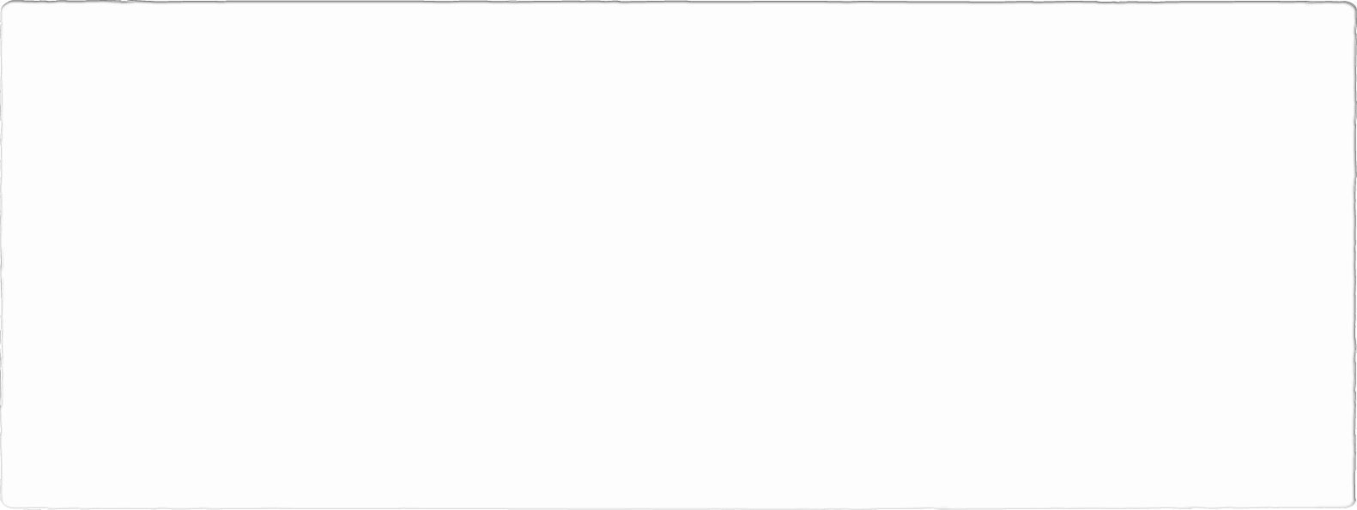
Cura
FALL 2022 CAPSTONE PROJECT
Guided by: - HENRY WONG

Slide 2
Agenda
Overview
Minimum Viable Product
Technologies Used
User Stories
Acceptance Criteria
Retrospectives
Product Backlog
Sprint Backlog
Test Cases
Mock Designs
Future Tasks

Slide 3
Overview
Defined our product and key technologies used.
Developed a working understanding of the process:
Polished incorrect aspects such as :
Personas
Retrospective
Problem statement
Technology description
Worked on links attached in the presentation and submission.

Slide 4

Personas
Doctor
Tori is a doctor who is working at New York Health Center.
She will be having 30 to 40 appointments with patients everyday.
It is very hard to keep track of the appointment details and other information related to patient.
So by using hospital manage system, she can access the details of appointments easily.

Slide 5

Personas
Inventory Management
Jack is an inventor who works in Osmania hospital in UK .
He maintains the records of medical equipment's, drugs and surgical equipment.
He need to keep track of these items every day for smooth running of operations.
Using hospital management system, she can maintain database for this items and access their availability easily.

Slide 6
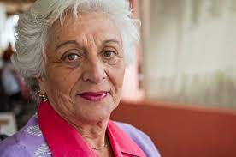
Personas
Patient
Mary is 81 years old.
She is suffering from auto-immune disease, lyme disease and asthma. Lives in Aurburn in Alabama, US.
Undergoes checkup every month ,But every time she has to fill appointment form and wait hours for the doctor.
By using Hospital management system, she can fill her details once and book appointment with doctor easily.

Slide 7

Personas
Admin
Henry is an admin of Texas State Hospital.
He plays a key role in the hospital management.
He manages the scheduling and appointments of doctors.
He plans departmental activities, evaluate doctors and other hospital employees, patient services
He creates and deletes all the roles.
By using hospital system management, he can organize the above activities easily.

Slide 8
MVP
AUTHENTICATION:-
CREATE ACCOUNT/REGISTER :- When the new registers the system sends an authentication mail to the registered email-id.
LOGIN/LOGOUT:-Every user can LOGIN and LOGOUT of the system.
When a registered user forgets his/her password the system provides help in retrieving the password and create a new password for the registered user.

Slide 9
MVP
INVENTORY MANAGEMENT:-
Admin has access to the inventory so that he/she can order the products according to the need of the hospital.
Doctors and staff also have access to browse the inventory details so that they can request for products.
Doctor can see if they have specific article to conduct a procedure or can request the Admin for the article when they need.

Slide 10
MVP
ACCESS TO RECORDS:-
The Admin will have access to all records consisting of patient records, Doctor records and details and Inventory records. This will aid the Admin to run and serve the hospital.
The Doctor will have access to records of all patients registered under him/her helping him/her to give a proper consultation to the patient. The doctor will also be able to see the inventory records.
The patient will all the records from bill statement to medical history and medication prescribed by the doctor coming under his/her name.

Slide 11

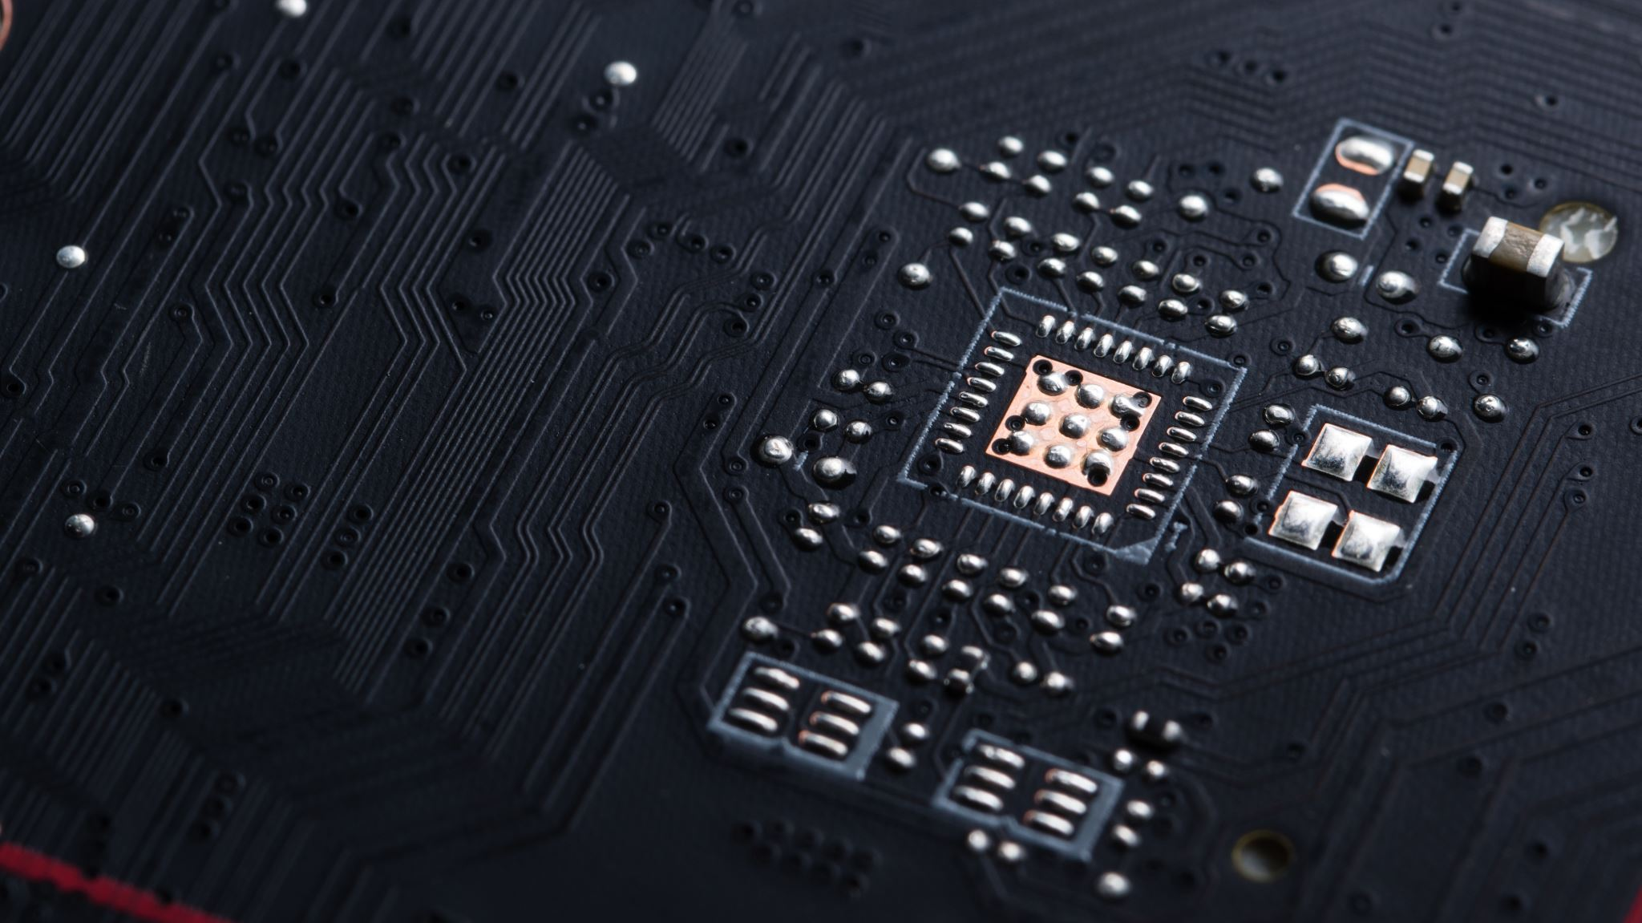

Technologies used

Slide 12

ARCHITECTURAL DIAGRAM

Slide 13
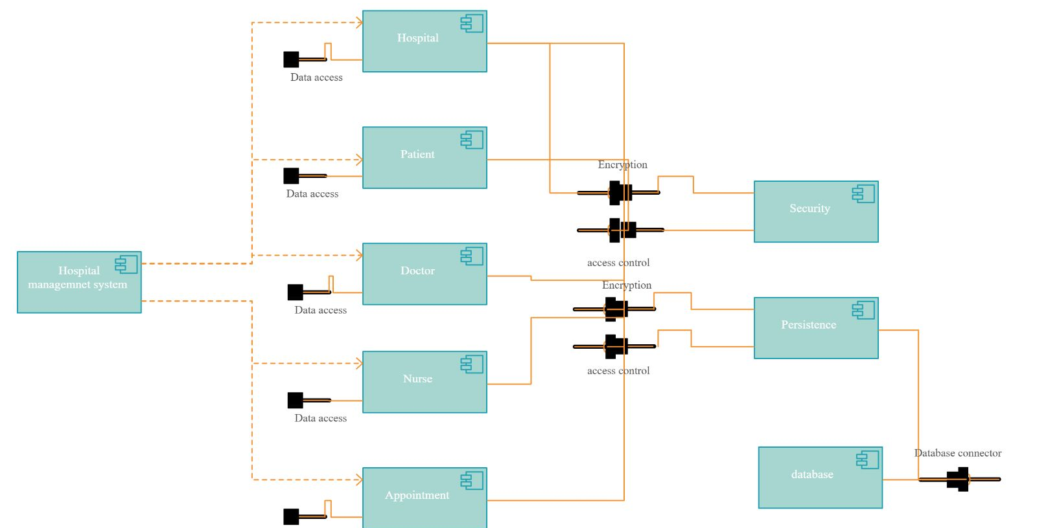

Slide 14
User Stories - Admin
Id | As | I want | so that
1 | Admin | To add/delete/update a doctor/staff/patient profile. | I can manage the system accordingly.
2 | Admin | To see the schedule of the doctor and staff of the hospital. | I can pay a doctor and staff according to his/her service time.
3 | Admin | To see patient details and appointment history. | I can get an idea about patient’s activity on the system.

Slide 15
User Stories - Doctor
Id | As | I want | So that
4 | Doctor | To update my schedule and apply for leaves when needed. | I can have an idea of my schedule and leaves.
5 | Doctor | An option to cancel or reschedule an appointment. | I can notify the patients about the cancellation or rescheduling of an appointment.
6 |  | To update my profile. | To view my own profile and update it.
7 |  | To see the patient’s information. | I can get an idea about the patient's current health situation.

Slide 16
User Stories - Patient
Id | As | I want | So that
8 | Patient | An easy way to register. | I can have a hassle-free experience while creating my profile/account.
9 | Patient | Some information from helpdesk to resolve my doubts. | I can get an idea to solve my doubts.
10 | Patient | An option to search doctor’s profile and his research works. | I can easily find a particular doctor with a specific specialization.
11 | Patient | An option to download my prescription. | I can download the hardcopy of the prescription .

Slide 17
User Stories - Staff
Id | As | I want | So that
12 | Staff | To know the supply of the inventory, drugs, medical and surgical equipment's. | I can know the update and availability on the supply for the inventory, drugs, medical and surgical equipment's.
13 | Patient | To update the patient’s details in the portal. | I can update the patient’s profile on the portal so that patient can view their details at any time.

Slide 18
User Stories - Pathologist
Id | As | I want | So that
12 | Pathologist | To add/update the equipment details in the portal. | Admin can help me update the supply of the equipments in the hospital.
13 | Patient | To add/update the patient’s test details in the portal. | Patient can view his test results at any moment.

Slide 19
Acceptance Criteria - Admin
Id | As a | Acceptance Criteria
1 | Admin | a) Administration can add/delete a doctor profile. b) Administration can also add necessary information in the doctor's profile. c) Administration can also add a tag to a doctor's profile. d) Administration can also delete a patient profile if needed.
2 | Admin | a) Administration can see the total working hours a doctor spends on consulting patients. b) Administration can see the doctor’s log-in and log-out.
3 | Admin | a) Administration can see patient's information. b) Administration can check patient's total appointments scheduled.

Slide 20
Acceptance Criteria - Doctor
Id | As a | Acceptance Criteria
4 | Doctor | a) Doctor will see the necessary information of the patient. b) If there is an availability of previous prescriptions, doctor will be able to proceed further for any treatment or diagnosis. c) Doctor will also be able to give downloadable prescriptions to the patient.
5 | Doctor | a) If needed, the doctor will be able to cancel an appointment at least prior 8 hours of the consultation scheduled. b) If the patient agrees, the doctor will be able to reschedule an appointment. c) The patient will be notified through SMS/Email.

Slide 21
Acceptance Criteria - Patient
Id | As a | Acceptance Criteria
6 | Patient | a)Anyone can register in this system, providing some necessary information. b)The information can be changed anytime after creation of the profile. c)User has to give some necessary information about his health status.
7 |  | a) User can ask his questions or doubts to the help desk. b) After providing symptoms, the best suggestion will be given from the help desk. c)User can contact by email or conduct a virtual meeting with the desk if necessary.
8 |  | a) The search result will contain doctors' names with their rating rated by other patients. b) The available time and date of the doctors will be in the search result. c) User can also search a doctor by typing the disease name/tag or specialization field.
9 |  | As soon as the doctor provide the prescription, then he will be able to download the same.

Slide 22
Mock-up design

Slide 23
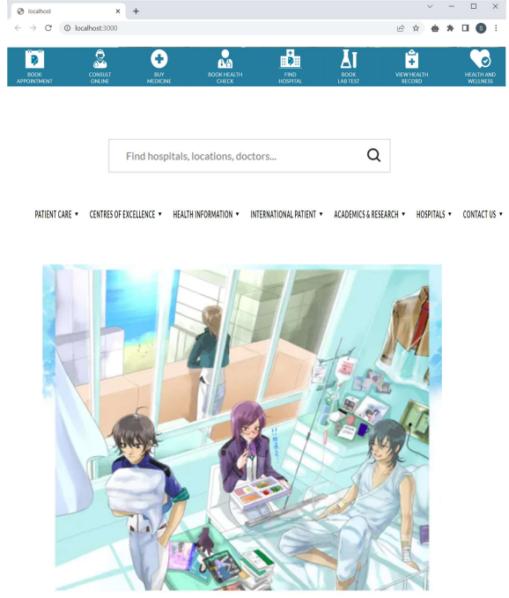
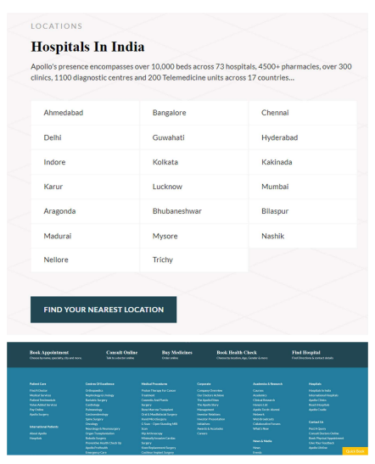

Slide 24
Testcases
Test Scenario | Test cases | Test data | Expected output
Sign Up / Registration | 1) Click on signup button. 2) Filling all the fields. 3) Selecting username & password. 4) Submit the signup form. 5)Email validation. 6) Password validation. | abc@gmail.com abc123 | 1) Should open Signup form. 2) Able to fill all the fields and if left empty it should raise error. 3) Able to choose unique username & strong password. 4) Able to submit the signup form after entering all fields and data sent to server. 5) If entered incorrect form of email,it should raise the error 6) If password length is less than minimum length it should raise the error.

Slide 25
Testcases
Test Scenario | Test cases | Test data | Expected output
Sign In / Login | 1) Opening Login Form 2) User Login 3) User Forgot Password 4)Submit the login Form | abc@gmail.com abc123 | 1) Able to open login page. 2) If entered incorrect username or password it should raise the error. 3) If incorrect password entered it should raise error and give reset option. 4) Able to submit and get logged in.

Slide 26
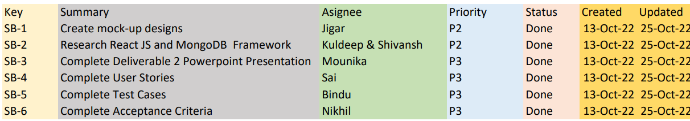
Sprint Backlog

Slide 27
ProductBacklog

Slide 28
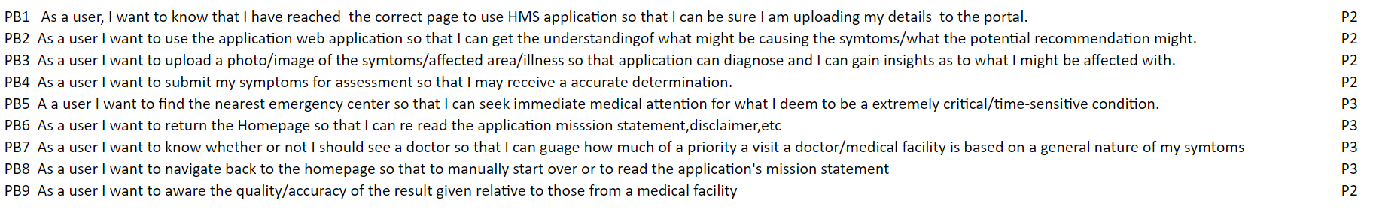

Slide 29
Metrics
Team velocity
Burndown charts

Slide 30
Team velocity
Sprint.no | No. of tasks
1 | 10 .
2 | 17 20
X-axis : Sprint
Y-axis : No. of days taken

Slide 31
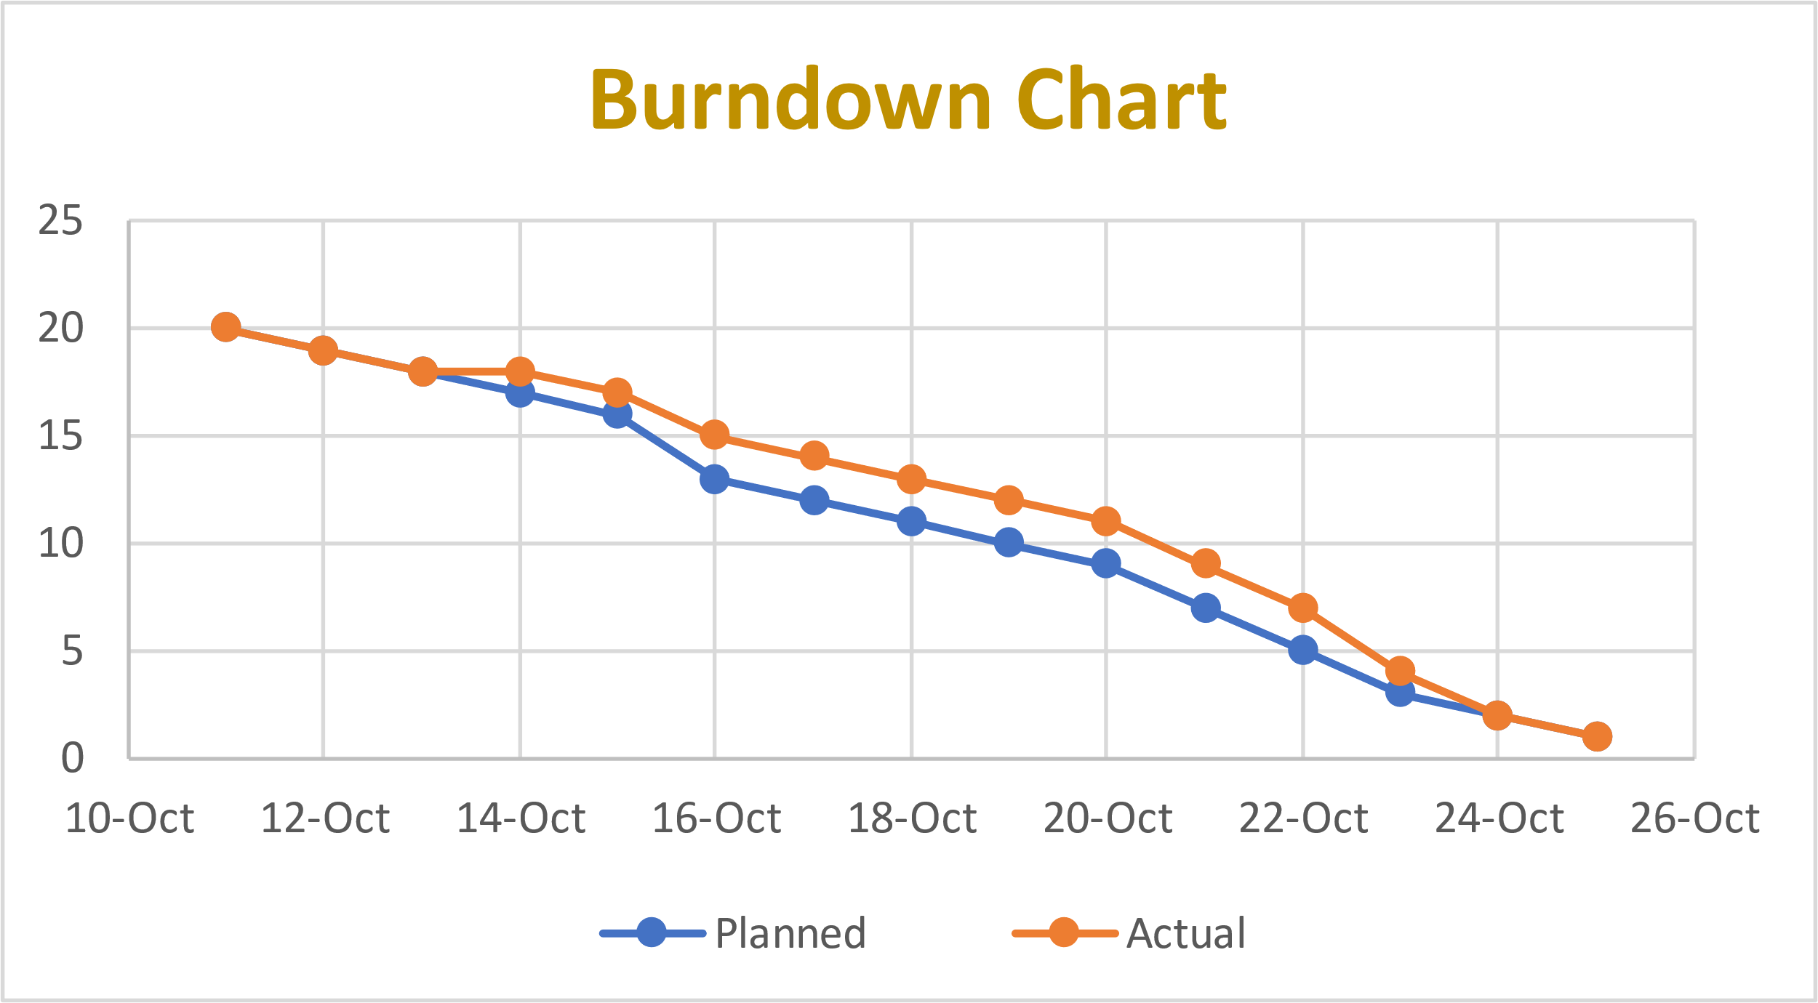

Slide 32
Burndown chart
Tasks | Calender Days | Planned | Actual
MVP | 11-Oct | 20 | 20
Technolgies to be used | 12-Oct | 19 | 19
Architectural diagram | 13-Oct | 18 | 18
Product Backlog | 14-Oct | 17 | 18
Product Backlog | 15-Oct | 16 | 17
User stories with acceptance criteria | 16-Oct | 13 | 15
User stories with acceptance criteria | 17-Oct | 12 | 14
Sprint Backlog | 18-Oct | 11 | 13
Test cases | 19-Oct | 10 | 12
Test cases | 20-Oct | 9 | 11
Stories completed | 21-Oct | 7 | 9
Stories not completed | 22-Oct | 5 | 7
Stories or tasks committed | 23-Oct | 3 | 4
Metrics | 24-Oct | 2 | 2
Burndown charts | 25-Oct | 1 | 1

Slide 33
Retrospectives
What went well?
Team improved in working and involving to task which was assigned to them.
What need to be improved?
Helping and tracking progress of each other’s work

Slide 34
Retrospectives
What next?
Although we had idea, we need to more research about the front and backend technologies to be used in our project
What went well?
To develop login page, we specifically worked on react js

Slide 35
Wikilink
https://github.com/SaiTejjj/HMS/wiki/CURA---HMS

Slide 36
Thankyou from Team.

